Slide 1
Finding Patterns Between Level 2 Minutiae and Distance of the Minutiae from the Fingerprint Core
Project Manager and Lead Researcher - Ashwin Kaliyaperumal
Statistician - Krish Katre

Slide 2

Introduction and Purpose
Purpose:
“more research is needed regarding the discriminating values of the various ridge formations…” – NAS Report: Strengthening Forensic Science in the US
Purpose - quantifying frequency of RE, bifur. and distances from the core of the fingerprint (FP) and finding any relationships
Improvements - Computer algorithm to identify minutiae
removes experimenter bias
Real-world Impact - Help create better statistical models to predict accuracy of FP identification from limited minutiae
Criteria:
Level 2 minutiae classification (individual) – ridge endings and bifurcations
Distance from core to minutia (class) - in pixels
Caption: Diagram of Ridge Endings and Bifurcations used by Gutiérrez-Redomero et al.
Notes:
goes on right thumb (F1) to right pinky (F5) and repeats process from left thumb (F6) to left pinky (F10)

Slide 3
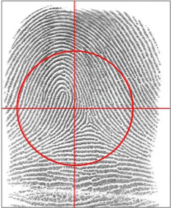
Research Process
Gutiérrez-Redomero, E., Alonso-Rodríguez, C., Hernández-Hurtado, L. E., & Rodríguez-Villalba, J. L. (2011). Distribution of the minutiae in the fingerprints of a sample of the Spanish population. Forensic Science International, 208(1-3), 79–90. https://doi.org/10.1016/j.forsciint.2010.11.006
Methodology
Analyzed frequencies of minutia in different sectors of fingerprint
Used sectors to categorize minutia location
Counted minutiae by hand
Results
Found need to account for area where minutiae is present
“the weight of the evidence of a minutia, such as the ridge endings…cannot be the same as that of a bifurcation...[This] shows the need to take into account. the finger area in which they are evaluated”
Caption: FP ridge count areas for a sample fingerprint from Gutiérrez-Redomero et al.

Slide 4
Calculating Average Minutia Distance
START
Get plain FP’s – Recording Legible Fingerprints FBI Procedure
Caption: Flowchart of our Standard Operating Procedure to calculate the Average Minutia Distance for ridge endings and bifurcations
Fingerprints to
analyze?
No
Sort data in CSV file by finger #
Yes
Sort data for each finger # by minutiae type
Use Ridge orientation approach to find minutiae and calculate radius from core
Create graph of freq. of minutiae vs dist. from core
Scan ink fingerprints into PNG
Use line graph to calculate Average Minutia Distance
Input data into CSV file
Data Collection
Data Processing

Slide 5

New Standard Operating Procedure
Average Minutiae Distance (AMD) – avg. dist. of minutiae from core for a specific finger
Formula - $\frac{\sum_{i}^{m}{{if}_{i}}}{m}$
m – max distance from core (in pixels)
f_{i} – frequency of minutiae i pixels away from core
i – dist from core (in pixels)
lower AMD -> minutiae more frequent near core
higher AMD -> minutiae more frequent near FP edges
Can be used to assign importance to minutiae on unidentified FP
If minutiae has high AMD but is found mostly near core -> shows it is a less common FP

Slide 6
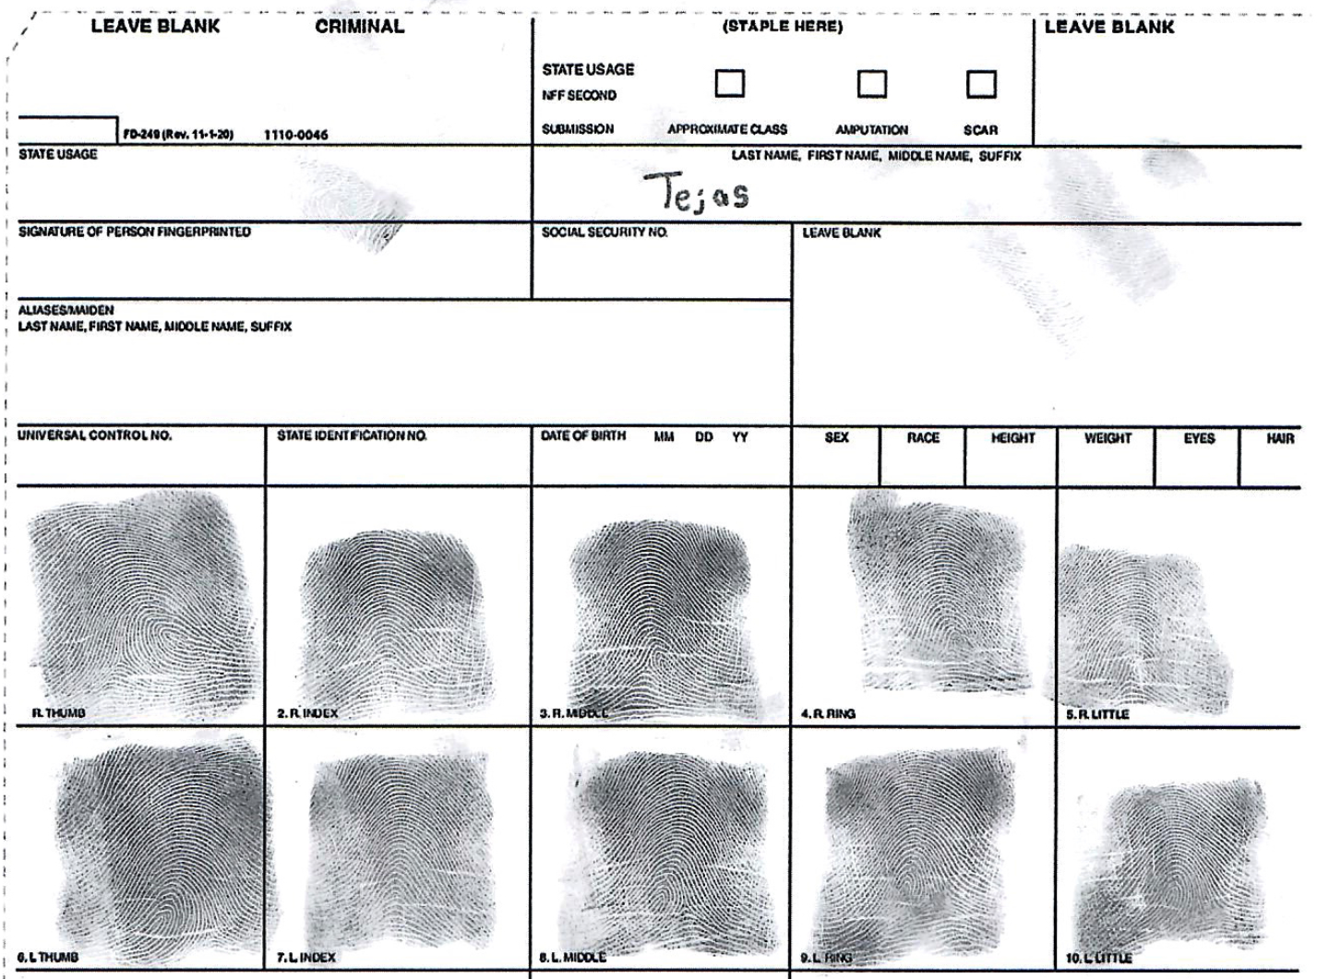
Data Collection
Collected inked FP’s
Copy of a Standard Fingerprint Card (FD-258)
FP procedure (Type 4 and Type 14) from FBI (https://le.fbi.gov/science-and-lab-resources/biometrics-and-fingerprints/biometrics/recording-legible-fingerprints)
Additional data from NIST Special Database 300
has both rolled and plain FP
used ~3500 plain FP
Caption: Example of FP set from participant using Standard Fingerprint card FD-258 to get Type 4 (rolled) FP

Slide 7
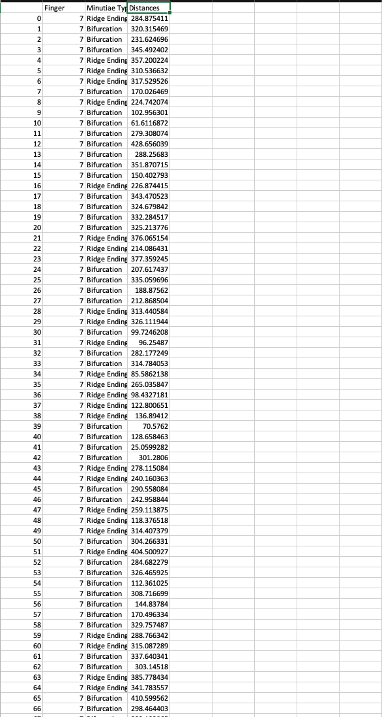
Link to Excel Spreadsheet Data
Trial #1:
https://lwsd-my.sharepoint.com/:x:/g/personal/s-akaliyaperumal_lwsd_org/ETUv06jmPgVCh8hEvixxaPYBNsK2gvYb3OVfOFK8X9zbeg?e=EMYGit
Trial #2:
https://lwsd-my.sharepoint.com/:x:/g/personal/s-akaliyaperumal_lwsd_org/EffTbK4CA7dGgCFmmKJsgkgBQwAiX25VCKE2Sl6dnnzY-g?e=M46Gvn

Slide 8
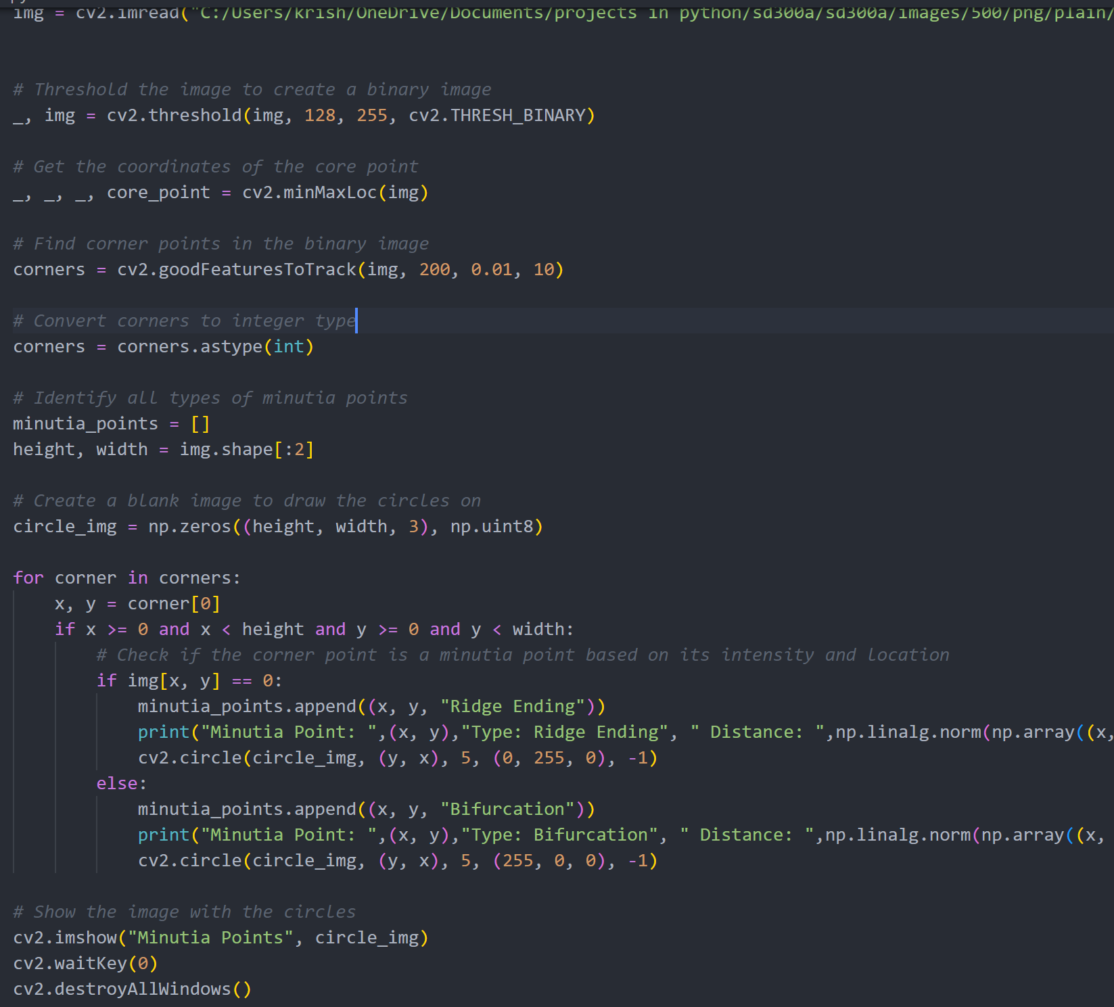
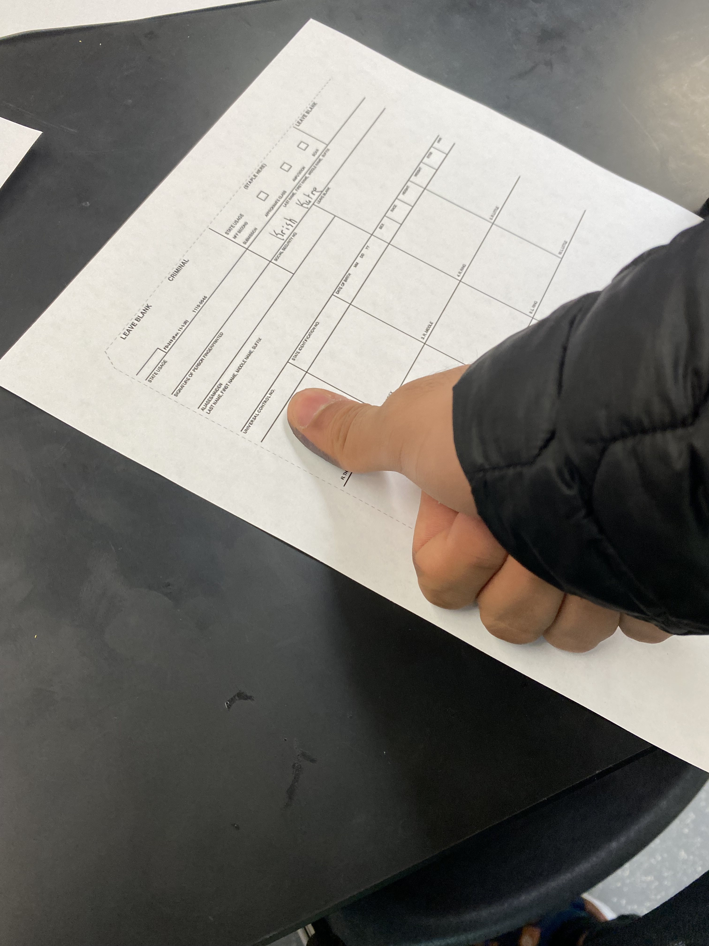
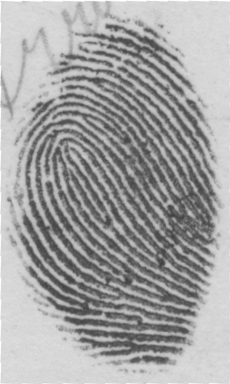
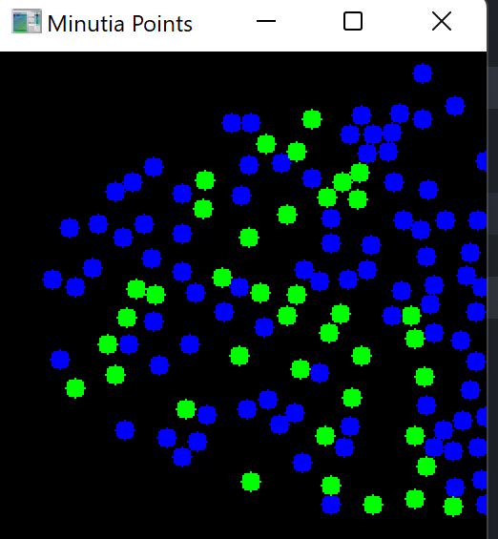
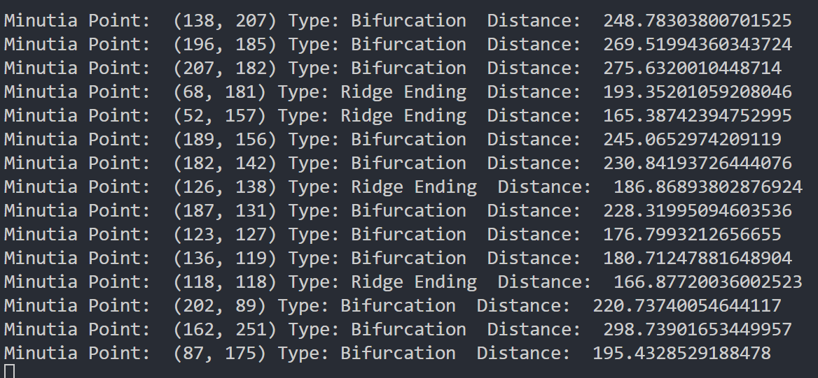
Pictures of Project
Example of acquiring plain FP
Code for identifying minutiae type and distance from core
Example of FP Image
Ridge Endings and bifurcations taken from above FP
Output of above code

Slide 9
Variables
Independent Variable (x-axis)
Intervals of Distance from Core of FP (in pixels)
Dependent Variable (y-axis)
The Frequency of Minutiae in the specified distance range

Slide 10
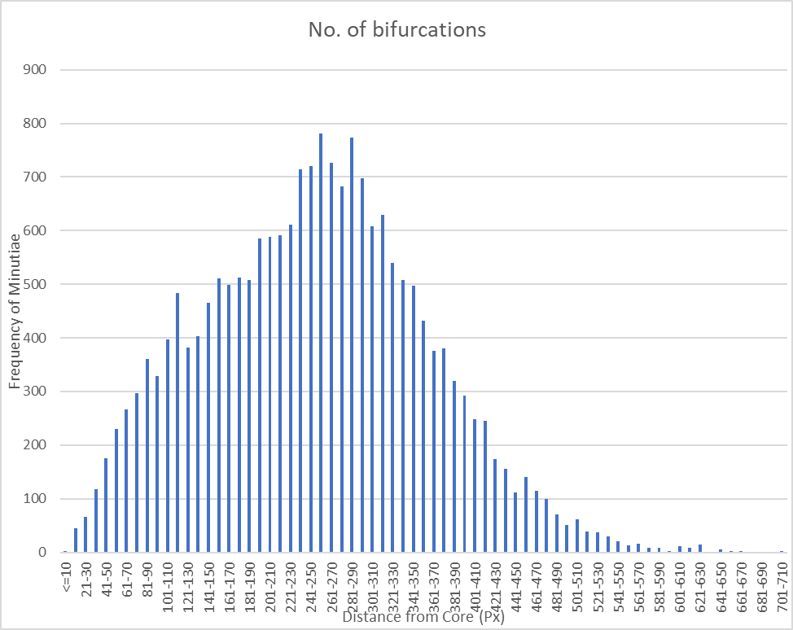
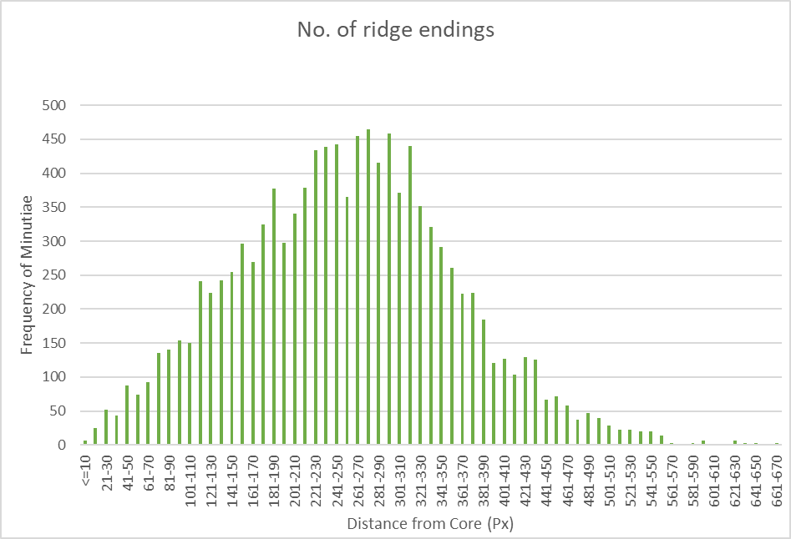
Graphs of Results (1st Trial)
Graph for Frequency of Bifurcations in Distance Ranges
Graph for Frequency of REs in Distance Ranges

Slide 11
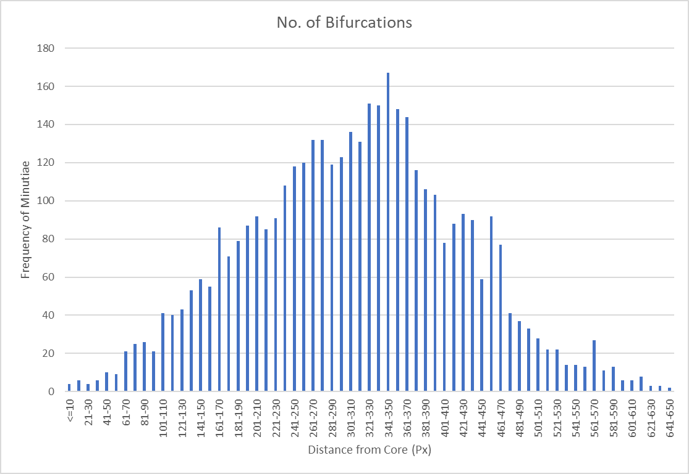
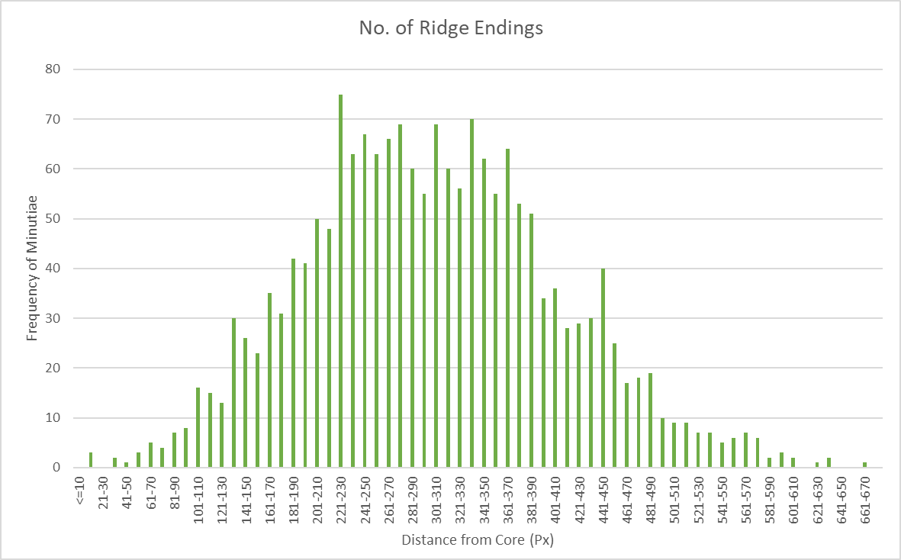
Graphs of Results (2nd Trial)
Graph for Frequency of Bifurcations in Distance Ranges
Graph for Frequency of REs in Distance Ranges

Slide 12

Calculations of Average Minutiae Distance (AMD)
Formula - $\frac{\sum_{i}^{m}{{if}_{i}}}{m}$
m – max distance from core (in pixels)
f_{i} – frequency of minutiae i pixels away from core
i – dist from core (in pixels)
Trial 1 for REs and Bifurcations Together:
Bifur - $\frac{\sum_{i}^{667}{{if}_{i}}}{667}$ = 254.8 pixels
RE - $\frac{\sum_{i}^{667}{{if}_{i}}}{667}$ = 271.2 pixels
Trial 2 for REs and Bifurcations Together:
Bifur - $\frac{\sum_{i}^{702}{{if}_{i}}}{702}$ = 343.6 pixels
RE - $\frac{\sum_{i}^{702}{{if}_{i}}}{702}$ = 285.1 pixels

Slide 13
Conclusion
Minutiae found mostly in the mid range, few found near edge of print and few found close to core
More bifurcations found than ridge endings
Likelihood of finding both types of prints is highest in between the core and the edge of print
Next Steps
Research frequency for other Level 2 minutia – convergence, break, enclosure, etc.
Control for other factors – sex, Level 1 features (loops, whorls, arches)
Contact the Seattle Police Department

Slide 14
Bibliography
Gutiérrez-Redomero, E., Alonso-Rodríguez, C., Hernández-Hurtado, L. E., & Rodríguez-Villalba, J. L. (2011). Distribution of the minutiae in the fingerprints of a sample of the Spanish population. Forensic Science International, 208(1-3), 79–90. https://doi.org/10.1016/j.forsciint.2010.11.006
Recording Legible Fingerprints. (n.d.). Law Enforcement. https://le.fbi.gov/science-and-lab-resources/biometrics-and-fingerprints/biometrics/recording-legible-fingerprints
‌Zaeri, N. (2011). Minutiae-based Fingerprint Extraction and Recognition. In www.intechopen.com. IntechOpen. https://www.intechopen.com/chapters/16502
NIST Special Database 300. (2018). NIST. https://www.nist.gov/itl/iad/image-group/nist-special-database-300

